Slide 1
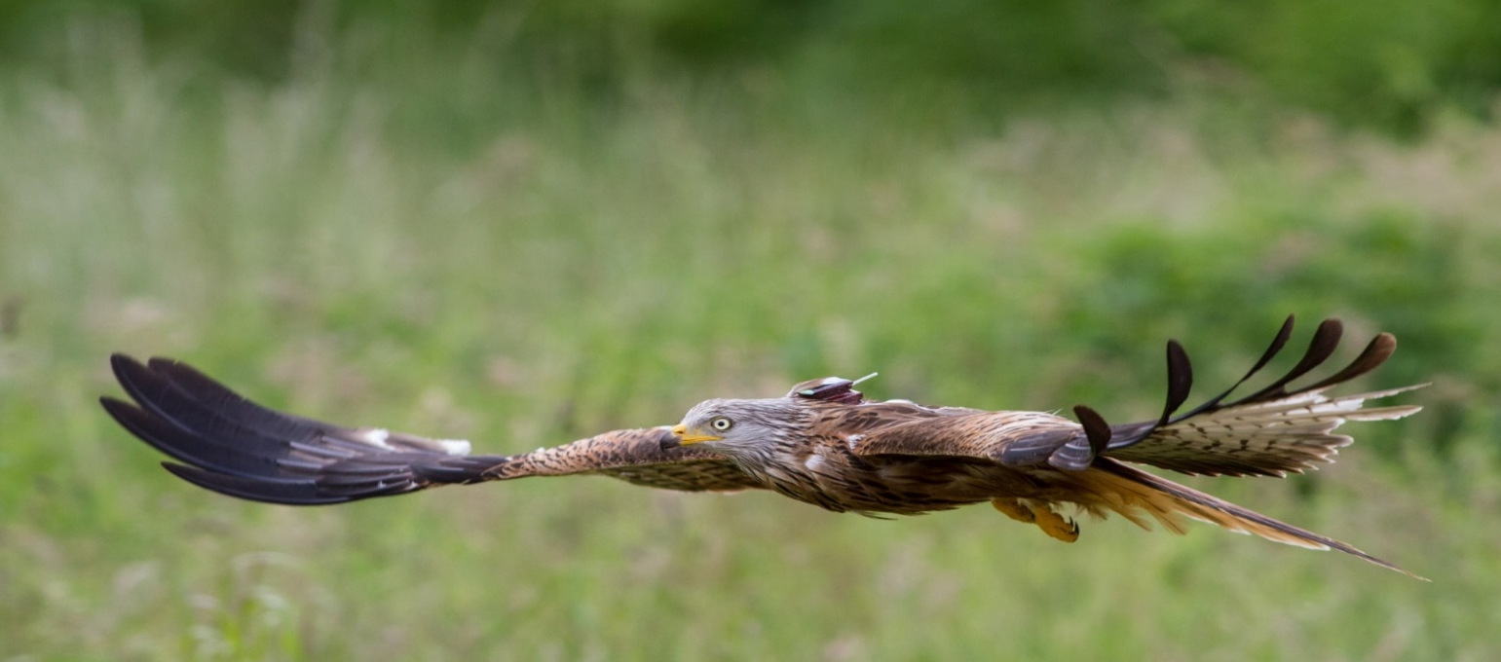
NestTool – extracting reproductive parameters from tracking data
Steffen Oppel, Ursin M. Beeli, Martin U. Grüebler, Valentijn S. van Bergen, Martin Kolbe, Thomas Pfeiffer, Patrick Scherler

Slide 2
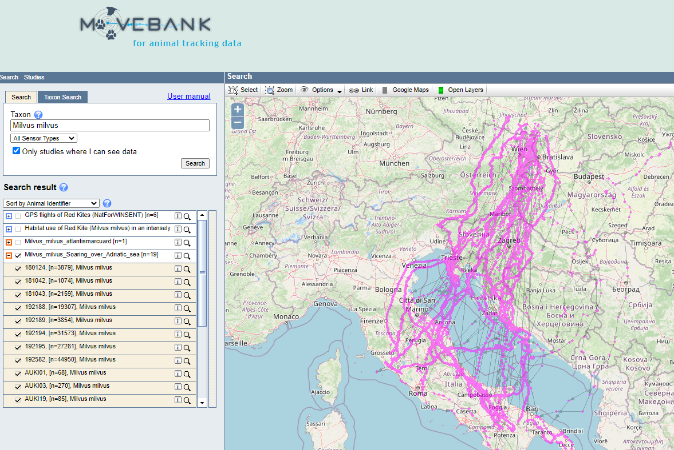

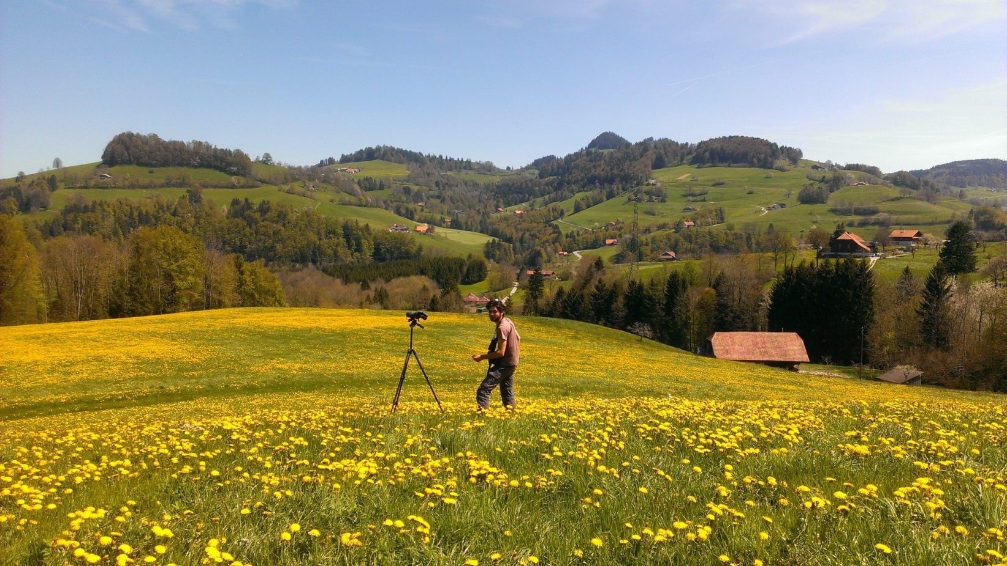




Demographic parameters to understand populations
population dynamics can be estimated with demographic parameters
data collection in the field is labour-intensive
we can use existing telemetry data to extract some demographic parameters
productivity
immigration
Population
emigration
mortality

Slide 3
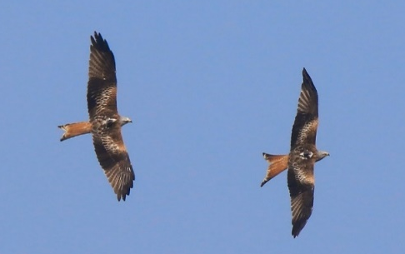
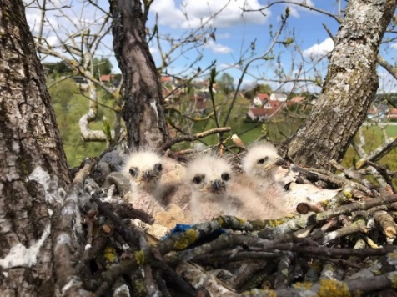
Typical movement patterns of breeding birds
breeding birds spend a lot of time in their territory and frequently visit their nest site
telemetry data can portray these movement patterns

Slide 4
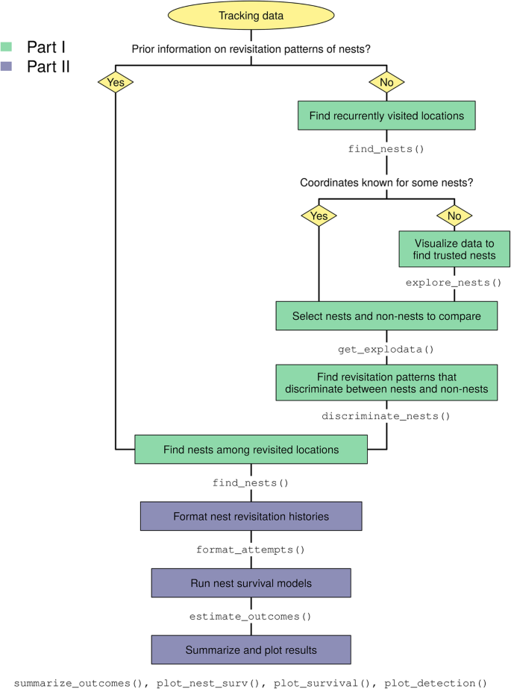
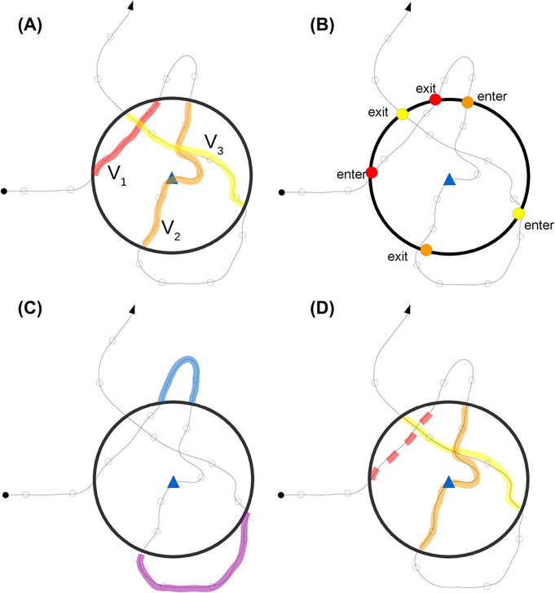



NestTool to estimate productivity parameters
existing tool (nestR) is computationally very intensive
NestTool calculates 42 variables over the breeding season of each bird
three random forest models predict whether:
- the tracked bird had a home range / territory
- the tracked bird was breeding
- the nest was successful
user-friendly R package freely available: www.github.com/Vogelwarte/NestTool
nestR | NestTool
174 minutes | 12 minutes
Picardi et al. 2020, Movement Ecology.
Bracis et al. 2018, Ecography.

Slide 5
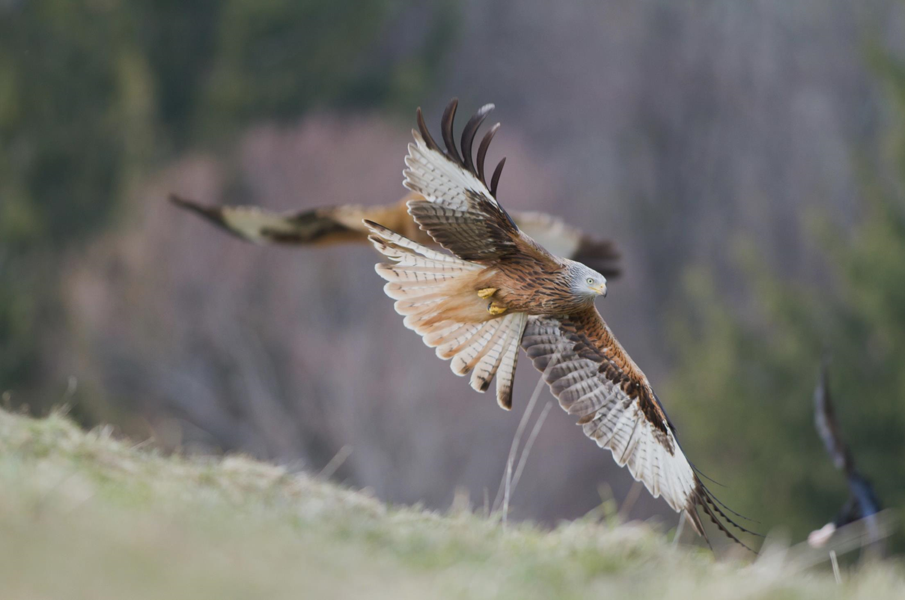
DISCLAIMER
We developed this tool for one species and a specific study – there is no guarantee that it will work for all species everywhere!
https://github.com/Vogelwarte/NestTool/issues

Slide 6
Prerequisites for using NestTool
sufficient telemetry data from birds during their breeding season including day and night locations!
basic information about birds (age, sex) that may affect their movement
general understanding about phenology of the species
validated training data with known outcome (breeding and/or success)
with validated training data you can train your own model for your species and study system
without validated training data you can apply the NestTool models to your species and study system – under the assumption that movement is similar to red kites

Slide 7
Typical workflow for NestTool
prepare your tracking data and metadata
fit a model for breeding probability
apply the breeding model for breeding probability to all your data
use output to fit model for breeding success
apply the success model to all your data

Slide 8
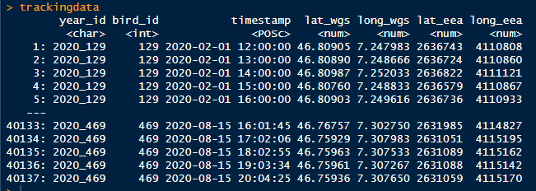
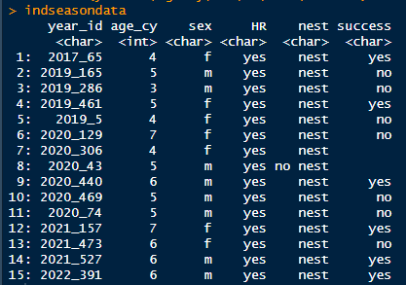
Data preparation for NestTool
arrange your tracking data in a vertical data.frame with the following columns:
arrange your metadata in a vertical data.frame with one line per individual season and the following columns:
use the function «data_prep» to calculate the movement variables

Slide 9
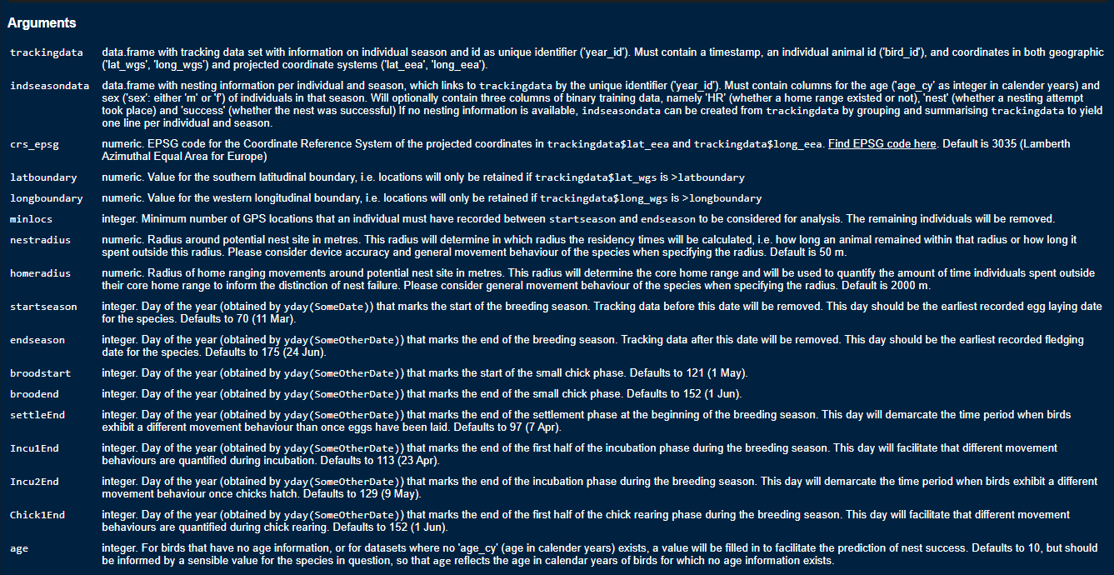
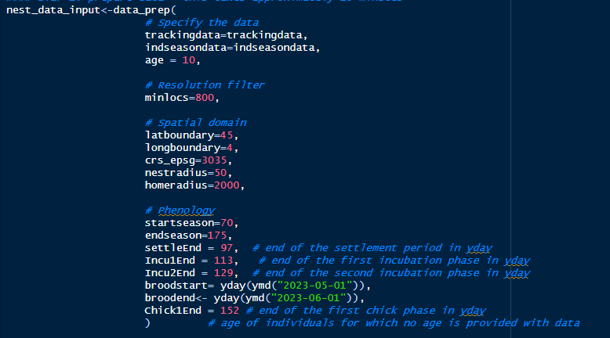
Key parameters to specify for data_prep
type in ?data_prep to find all the definitions for input parameters
you need to specify data, a sample size filter, spatial buffers and filters and phenology

Slide 10
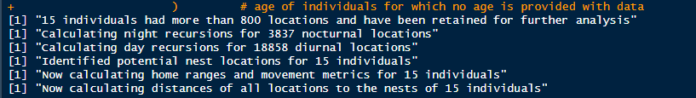
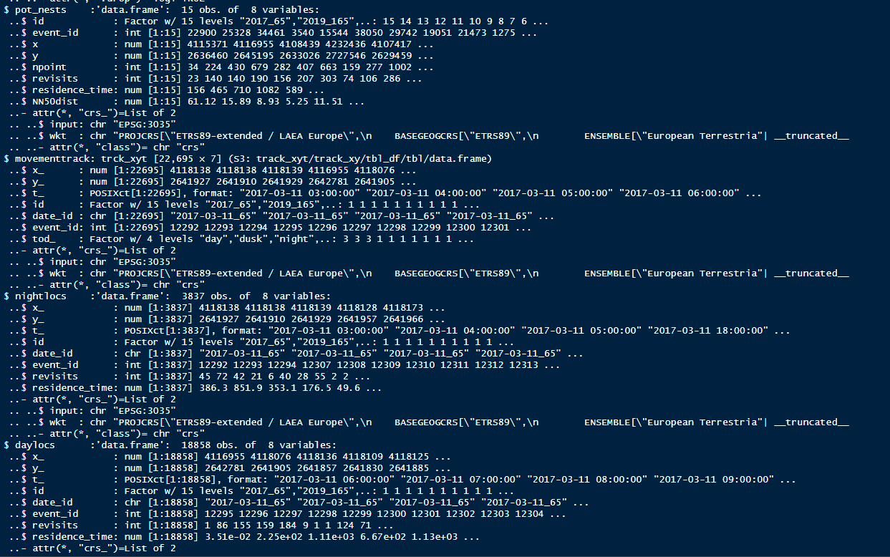
Running data_prep
function provides progress report
returns a list with 6 objects: summary, pot_nests, nightlocs, daylocs, movementtrack, and nest_visits – you need to specify which data.frame to use in subsequent functions

Slide 11
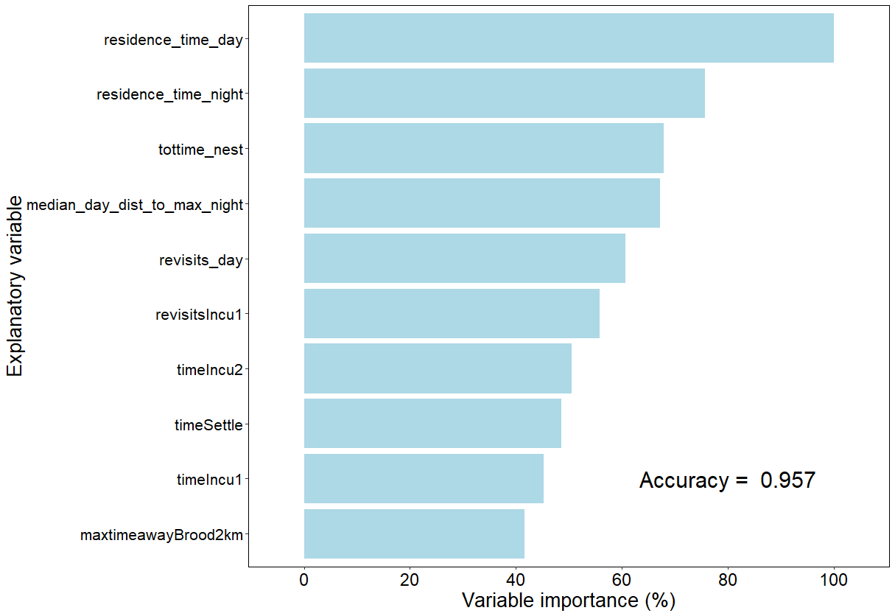
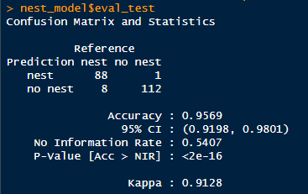
Fitting a nest model in NestTool
train_nest_detection very simple function with just three arguments
plot=T will result in a variable importance plot and accuracy assessment
returns a list with 5 objects: you need to specify $model to use model in subsequent functions

Slide 12
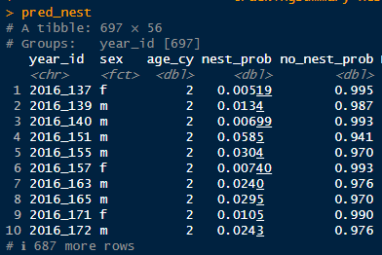
Applying a nest model from NestTool to new data
to apply a model you need two things: (1) a model, and (2) prepared data
predict_nesting is simple function where you just specify those two objects
output is a tibble that tells you the probability of a nest

Slide 13
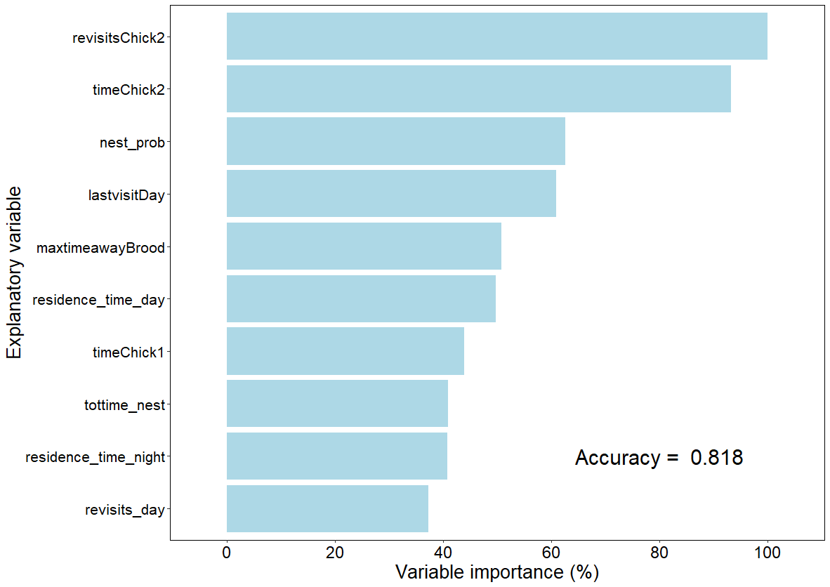
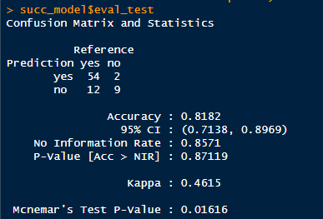
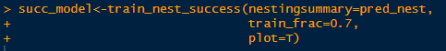
Fitting a success model in NestTool
you need output from a nest model
similar arguments as in other ‘train’ functions
returns a list with 5 objects: you need to specify $model to use model in subsequent functions

Slide 14
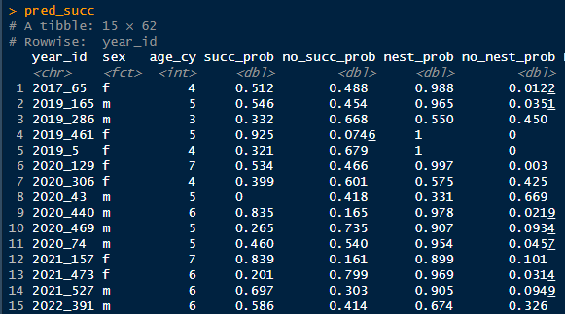
Applying a success model from NestTool to new data
to apply a model you need two things: (1) a model, and (2) prepared movement data with nest predictions
predict_success is simple function where you just specify those two objects, and a threshold for when you classify a success (e.g. 0.5)
output is a tibble that tells you the probability of a nest to have been successful – note that succ_prob is set to 0 if nest_prob is below threshold

Slide 15
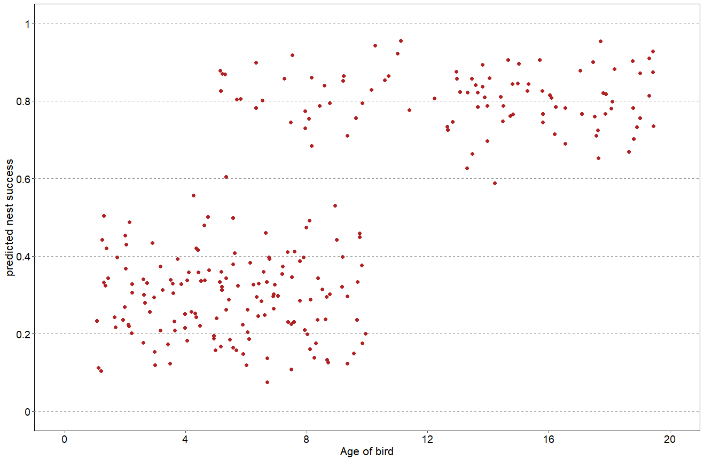
Predictions from NestTool come with uncertainty
‘predict’ functions report a probability – but if that is close to 0.5 the model is uncertain whether the nest was successful or not
multiple options: ignore, exclude, or manually annotate

Slide 16
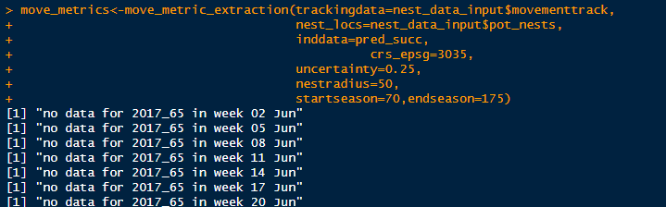
Manually inspecting and classifying uncertain cases
requires further data preparation for visualisation: move_metric_extraction
input needed are the movementtrack and pot_nests of the original data_prep output, predicted nest success, and some input parameters from data_prep
‘uncertainty’ parameter allows you to set the tolerance level – value close to 0 means that most cases will get flagged, close to 0.5 almost none

Slide 17
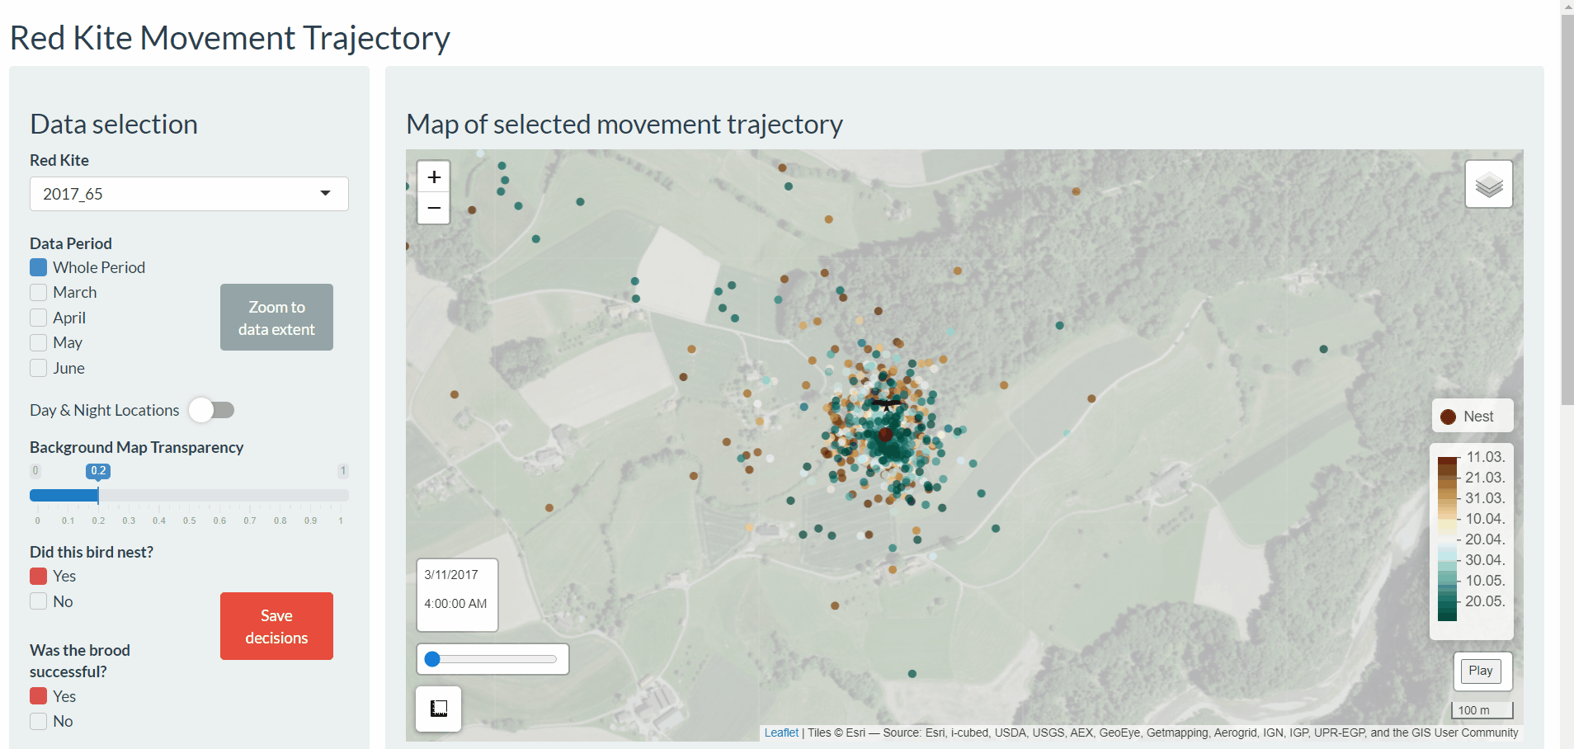
Manually re-classify uncertain cases

Slide 18
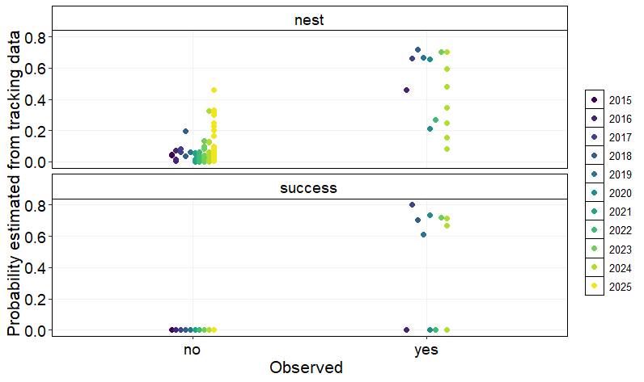
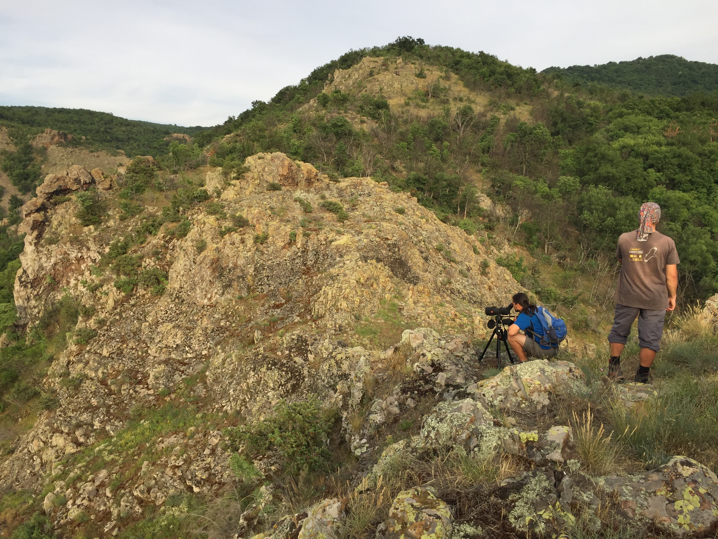
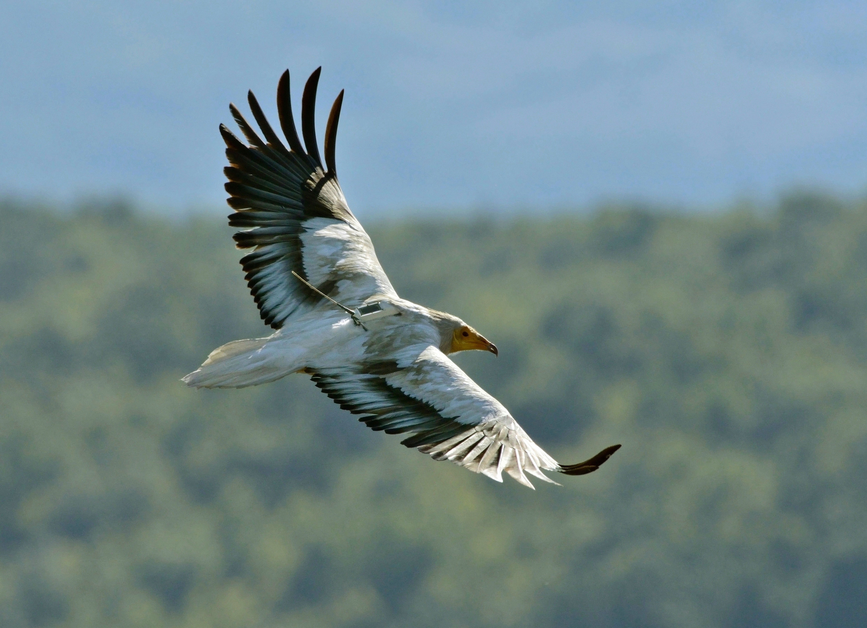
Summary
NestTool is useful to estimate breeding propensity and success
main limitations are that you must have sufficient tracking data
training data are necessary to build your own models – otherwise you have to rely on assumption of model transferability
works only retrospectively – for live nest detection check our app: https://vogelwarte.shinyapps.io/NestFind/
problems may arise for species that breed throughout the year

Slide 19
Any questions?

